Slide 1

Design & Verification of Low-Power Perceptron Based AI Engine
GOVERNMENT COLLEGE OF ENGINEERING, BARGUR
DEPARTMENT OF ELECTRONICS & COMMUNICATION ENGINEERING
Project Presented:
Mohammed Moienuddin Ali.S.A
Packya Muthukumar.M
Pradeep Palaniselvam.T
Vigneshkannan.R
Guided By:
Mrs. J. Nargis (Asst. Professor)
20.04.2026 (MONDAY)

Slide 2
Table of contents
01
02
03
04
05
06
Introduction
Architecture
RTL Design
Motivation • Objective
System • Perceptron
Modules • UART
Verification
Analysis
Future Work
Testbench • Simulation
Synthesis • Timing • Power
Enhancements

Slide 3
01
Introduction
Edge AI applications require low-power and low-latency inference. Hardware acceleration enables efficient implementation of neural computation compared to software execution.

Slide 4
Project Motivation
Artificial Intelligence inference is increasingly required in edge devices such as IoT nodes, wearable systems, and embedded controllers. Conventional software-based implementations on CPUs or GPUs introduce higher latency and power consumption, making them unsuitable for resource-constrained environments. Hardware acceleration offers parallelism, low latency, and energy efficiency, making it an attractive platform for deploying lightweight neural network models.
A perceptron-based architecture provides a simple yet effective hardware-friendly solution for binary classification tasks. Therefore, this project focuses on designing a low-power perceptron-based AI engine implemented in hardware for efficient real-time inference.

Slide 5
Project Objective
Design a perceptron-based AI inference engine using Verilog HDL
Implement UART-based feature input from host system
Perform hardware-based classification on FPGA
Optimize architecture for low-power operation
Verify functionality using simulation and synthesis reports
Demonstrate real-time prediction output

Slide 6
02
Architecture
The system receives feature data through UART, processes it using a perceptron computation core, and generates a classification output through an activation layer.

Slide 7
System Architecture
Laptop
UART RX Feature Input
Packet Parser Feature Extraction
Perceptron Core MAC Operation
Activation Layer Decision
UART TX Output
Prediction Output

Slide 8
Perceptron Model
The perceptron is a single-layer neural model used for binary classification. It computes a weighted sum of input features followed by bias addition. A threshold-based activation function is applied to generate the final prediction output.
y = 1 if ( Σ (wi × xi) + b ) ≥ threshold
y = 0 otherwise
The perceptron computes a weighted sum of features and applies thresholding to produce a binary classification output.
x0 – w0
x1 – w1
…
x7 – w7
Sum + Bias Activation Output

Slide 9
03
RTL Design
The design is implemented using modular Verilog blocks including communication, datapath, and control logic integrated into a top-level architecture.

Slide 10
RTL Design Overview
UART Receiver
Packet Parser
Communication
Top module
AI System top module integrated
Perceptron
core
Activation
layer
UART
Transmitter

Slide 11
RTL Modules
(A) ai_system_top
Integrates all modules into complete AI inference pipeline
(A.1) perceptron_core
(A.2) activation_layer
Performs weighted sum computation of input features
Applies threshold logic to generate binary prediction
(A.3) comm_top
Handles UART reception and groups incoming bytes into feature packets
(A.3.1) uart_rx
(A.3.2) packet_parser
Receives serial data and converts it into parallel feature values
Converts the parallel feature values into a packet through fsm
(A.4) uart_tx
Transmits prediction result back to host system

Slide 12
UART Communication
UART used for serial communication with host system
Receives feature data byte-by-byte
Operates at 115200 baud rate (8N1 format)
Converts serial input into parallel feature values
Transmits prediction result back via UART
Key Parameters
Baud Rate : 115200
Data Bits : 8
Parity : None
Stop Bits : 1
Clock : 50 MHz (configured)

Slide 13
04
Verification
Simulation waveforms confirm correct UART reception, feature parsing, weighted computation, and final classification output.

Slide 14
Testbench
A Verilog testbench is developed to verify the functionality of the AI system. It generates clock and reset signals and simulates UART input by sending feature data as serial packets. The system response is observed to ensure correct feature extraction, computation, and prediction output.
Clock Generator
Reset Logic
UART Stimulus (send_byte)
Feature Packet Input
Output Monitoring
Test Packet Example
Start : 0xAA
Features : 12, 8, -3, 4, 6, 2, 9, -1
End : 0x55

Slide 15
Testbench Code Snippet
task send_byte;
input [7:0] data;
integer i;
begin
rx = 0; #(BIT_PERIOD);
for (i = 0; i < 8; i = i + 1) begin
rx = data[i];
#(BIT_PERIOD);
end
rx = 1;
#(BIT_PERIOD);
end
endtask

Slide 16
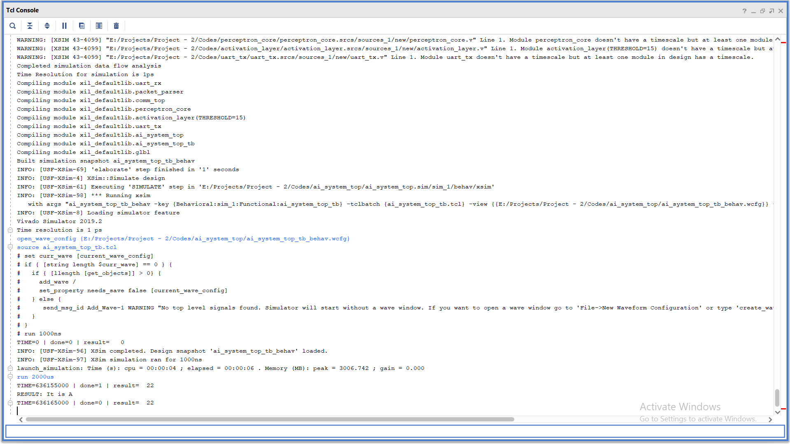
Simulation

Slide 17
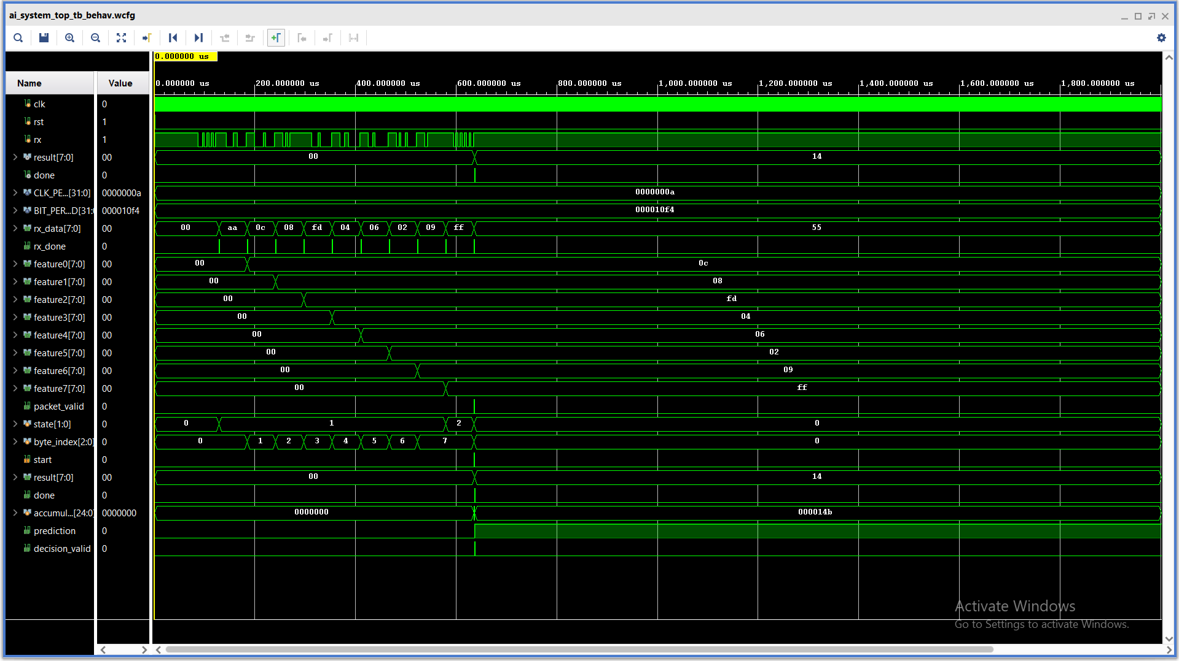

Slide 18
05
Analysis

Slide 19
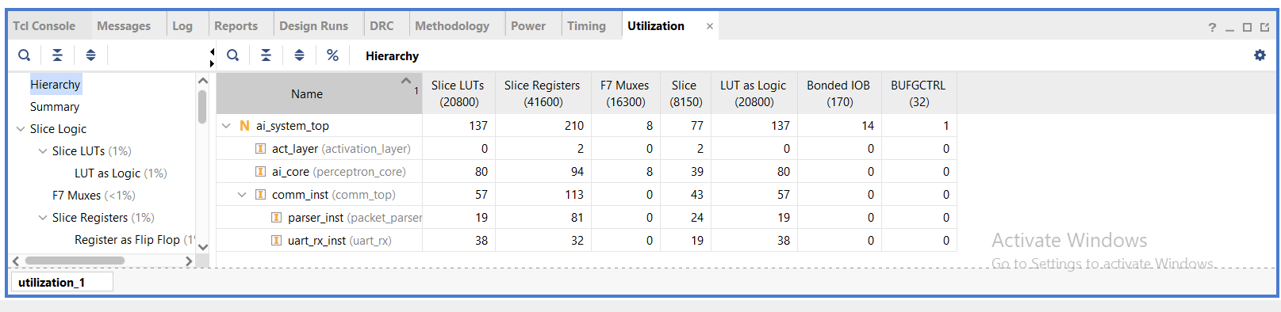
Vivado Synthesis Results
The RTL design is synthesized using Xilinx Vivado to evaluate hardware resource utilization. The synthesis results show efficient usage of LUTs, registers, and DSP slices, indicating that the perceptron-based AI engine is suitable for FPGA implementation.
Utilization Report

Slide 20
Vivado Synthesis Results
DSP usage → AI computation
Low LUT count → efficient design
Key Observations (Based on Utilization Report)
Resource | Usage
LUTs | 218(~1%)
Registers | 224(~1%)
I/O | 15
DSP/BRAM | Minimal/None

Slide 21
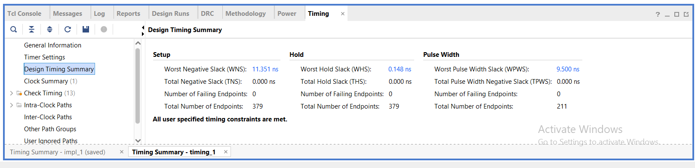
Timing Analysis
WNS > 0 → Timing met
TNS = 0 → No violations
Inference latency ≈ ~10 clock cycles
Suitable for real-time applications
“All User specified timing constraints are met.”

Slide 22
Low-power considerations
Dynamic Power ∝ Switching Activity × Capacitance × Frequency²
Low resource utilization (~1% LUTs, Registers)
Sequential MAC operation reduces switching activity
No large memory blocks (BRAM not used)
Minimal combinational complexity
Suitable for low-power edge AI applications
Uses sequential processing instead of parallel heavy logic
Only active during computation (not always switching)
Lightweight design → less power consumption
The lightweight architecture ensures energy-efficient AI inference suitable for edge devices.

Slide 23
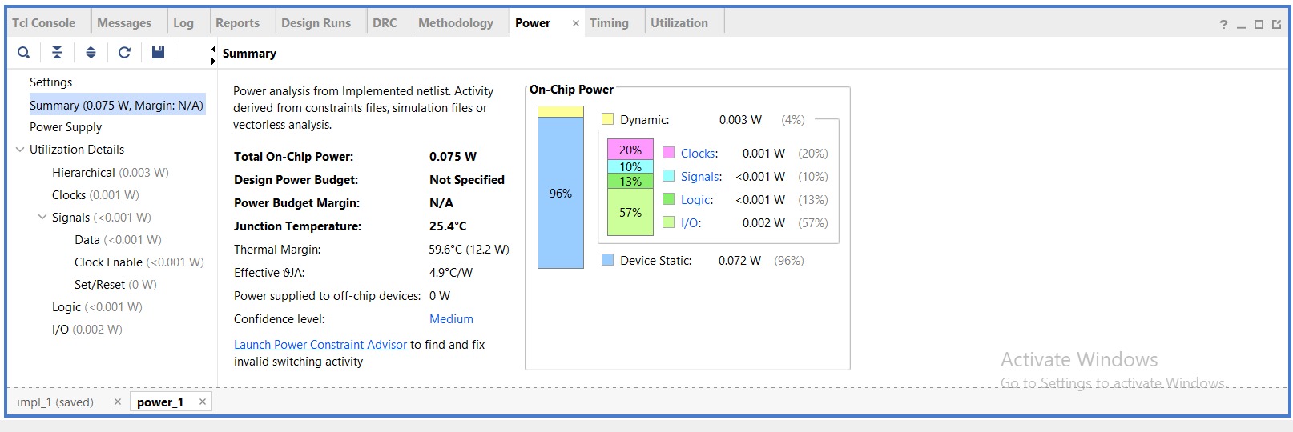
Low-power considerations
Dynamic Power ∝ Switching Activity × Capacitance × Frequency²

Slide 24
05
Future Work

Slide 25
Enhancements
From Single Neuron → Neural Network
From Fixed Weights → Trainable / Configurable System
From Prototype → Real Product
The current design can be extended to support more complex neural network architectures by incorporating multiple perceptron layers. Future enhancements include programmable weights, memory integration, pipeline optimization, and real-time deployment for practical edge AI applications.

Slide 26
Conclusion
This project successfully demonstrates the design and verification of a perceptron-based AI decision engine. The system is verified through simulation and achieves efficient resource utilization with timing closure. The lightweight and scalable architecture makes it suitable for low-power edge AI applications.
Real-time hardware validated ✔
Scalable architecture ✔
Industry-relevant design ✔

Slide 27
Interaction session!
Any queries?

Slide 28
Thank You!

